Slide 1
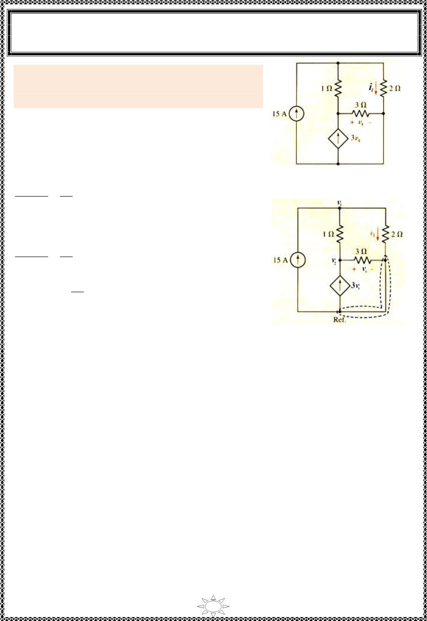
University of Diyala
Engineering College
Electronic Department
Electrical Engineering Fundamentals
1st Class
Asst., Lecturer : Wisam N. AL-Obaidi
Year (2013-2014)
Example 5: Determine the power supplied by the
dependent source of the Figure (4.11) using nodal
analys is.
Solution:
Redraw the circuit and indicate the nodes and reference
node as shown in Figure (4.12).
At node (1):
Figure (4.11)
푣 − 푣
푣
1
1
2
1
+
– 15 = 0,
2
∴ 1.5 v – v = 15
…(1)
1
2
At node (2):
푣 − 푣
푣
2
3
2
1
– 3푣 = 0, 푣 = 푣
1
+
푥
푥
2
Trail Version
Trail Version
Trail Version
Trail Version
Trail Version
Trail Version
Trail Version
Trail Version
Trail Version
Trail Version
Trail Version
Trail Version
Trail Version
∴
푣₂ − 푣₁
푣₂
3
– 3푣₂ = 0
}× 3
1
+
3 v – 3 v + v – 9푣 = 0
2
1
2
2
Figure (4.12)
∴ – 3 v – 5v = 0
…(2)
1
2
Solve Equ.s (1) & (2) we get,
v = 7.14 V & v = 푣 = – 4.29 V
1
2
푥
Now the power supplied by the dependent source is,
P = IV = (3푣 ) 푣 = (3×(– 4.29)) × (– 4.29) = 55.2 W
푥
푥
61

Slide 2
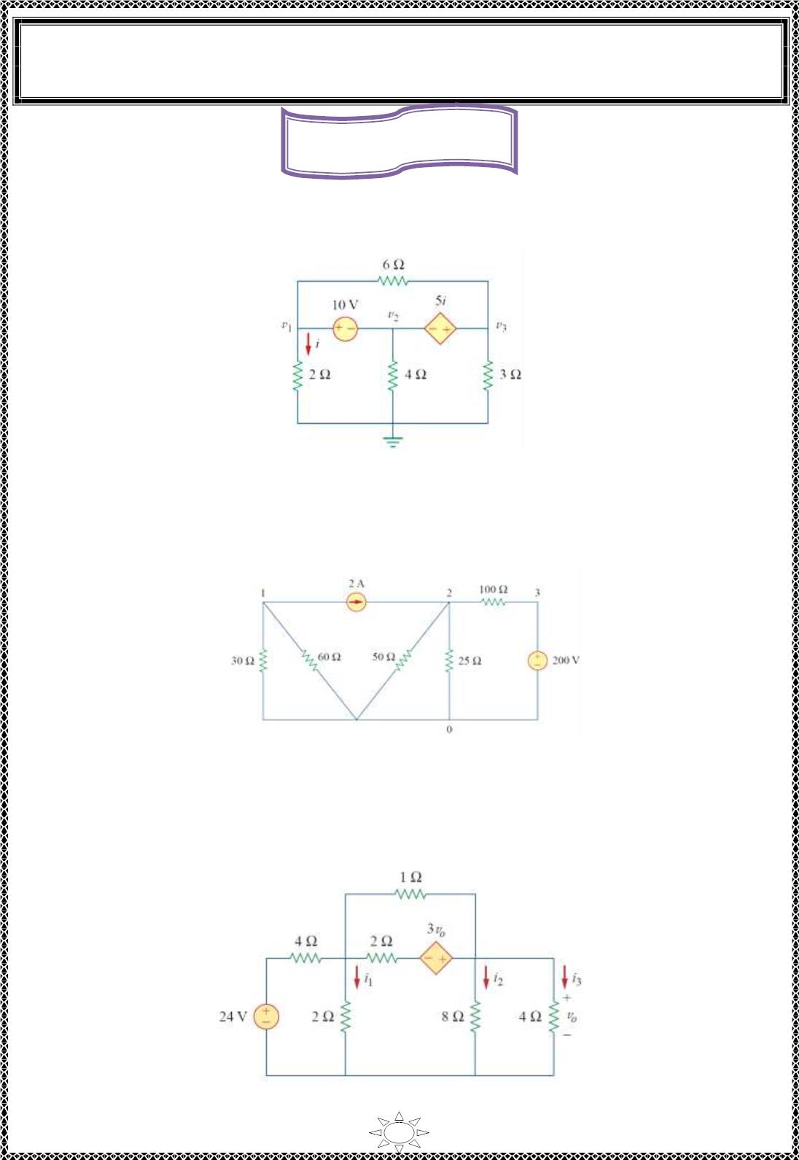
University of Diyala
Engineering College
Electronic Department
Electrical Engineering Fundamentals
1st Class
Asst., Lecturer : Wisam N. AL-Obaidi
Year (2013-2014)
Home Works
H.W.(1):- Find v , v and v in the circuit of Figure (4.13) us ing nodal analysis.
1
2
3
[ Answer: v = 3.043 V, v = – 6.956 V & v = 0.6522 V ]
1
2
3
Figure (4.13 )
Trail Version
Trail Version
Trail Version
Trail Version
Trail Version
Trail Version
Trail Version
Trail Version
Trail Version
Trail Version
Trail Version
Trail Version
Trail Version
H.W.(2):- Find v , v and v in the circuit of Figure (4.14) us ing nodal analysis.
1
2
3
[ Answer: v = – 40 V, v = 57.14 V & v = 200 V ]
1
2
3
Figure (4.14 )
H.W.(2):- Find v , v , v , i , i & i in the circuit of Figure (4.15 ) us ing nodal analys is.
1
2
o
1
2
3
[ Answer: v = 2.67V, v = 10.67 V & v = 10.67 V, i = 1.34A, i = 1.33A, i = 2.67A, i =
1
2
o
1
2
3
4
12A, i = −8A, i = 5.33A,]
5
6
Figure (4.15 )
62

Slide 3
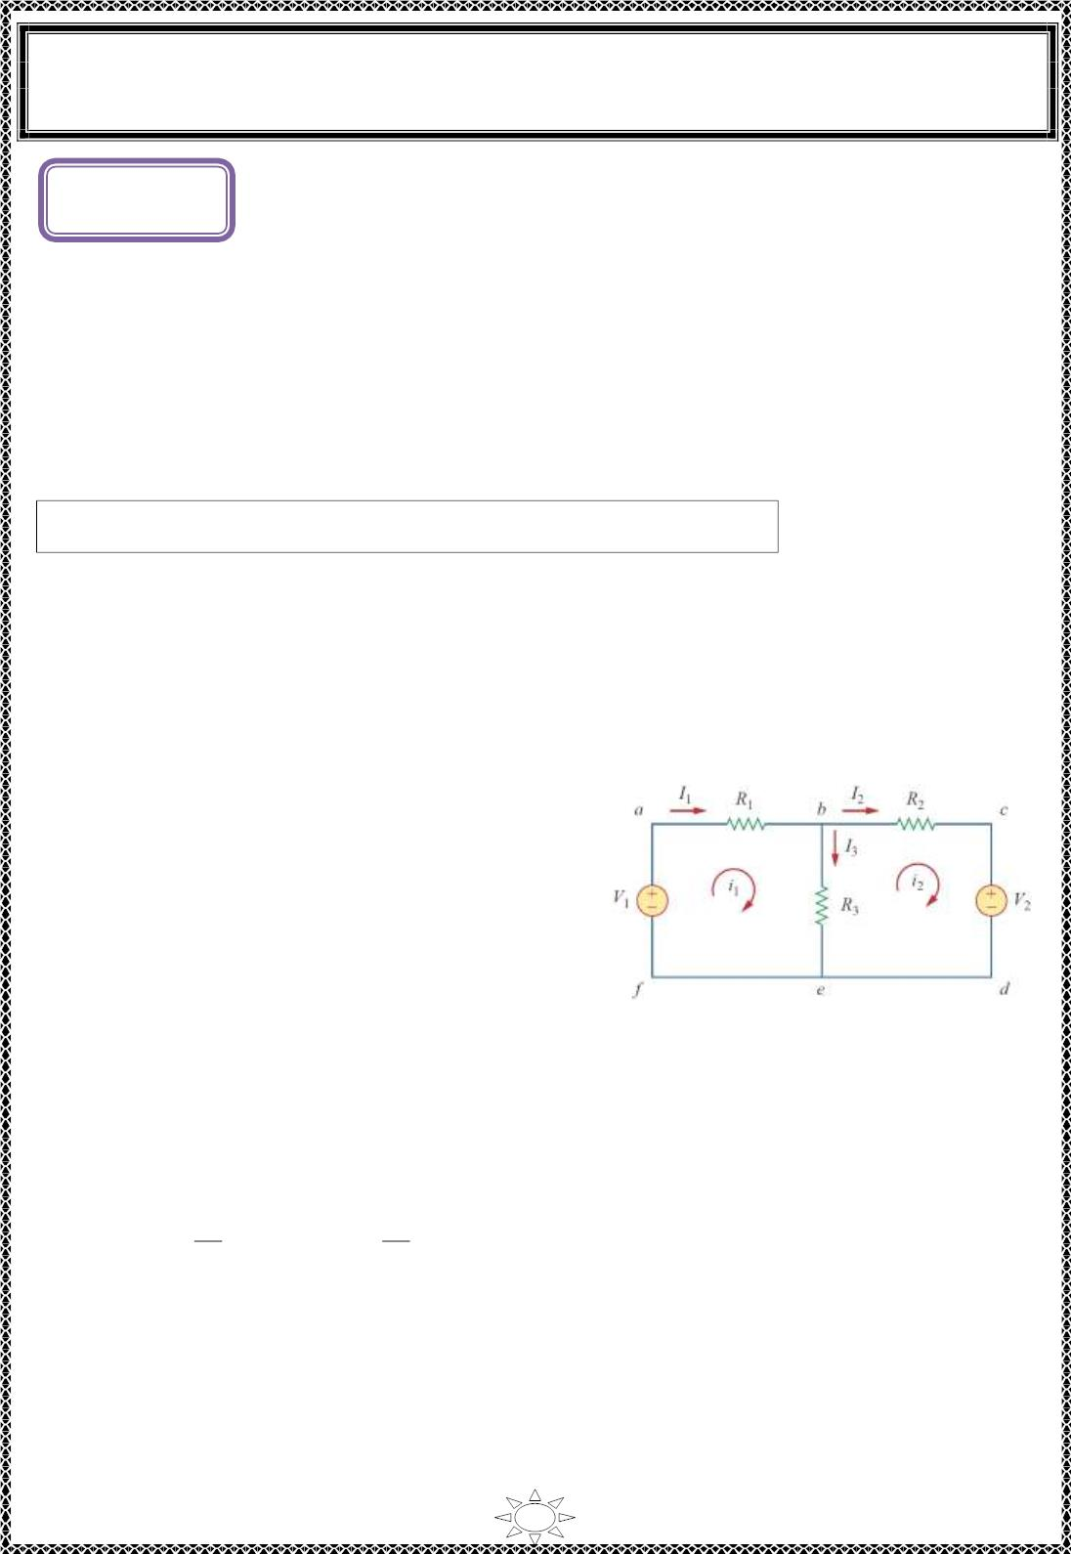
University of Diyala
Engineering College
Electronic Department
Electrical Engineering Fundamentals
1st Class
Asst., Lecturer : Wisam N. AL-Obaidi
Year (2013-2014)
L ectur e (5)
Mesh Analysis
(Maxwell’s Loop Curent Method)
Mes h analys is provides another general procedure for analy z in g circuits, using mesh
currents as the circuit variab les instead of branch currents (as in Kirchhoff's laws ) . Us ing
mesh currents instead of element currents as circuit variables is convenient and reduces the
number of equations that must be solved simultaneously. Mes h analys is applies KVL to
find unknown currents.
A mesh is a loop that does not contain any other loop wit h in it.
Steps to Determine Mesh Currents:
1. As s ign mesh currents to the n meshes.
2. Apply KVL to each of the n meshes. Use Ohm‘s law to express the voltages in terms of
the mesh currents.
3. Solve the result ing n simultaneous equations to get the mesh currents.
For the first loop:
Trail Version
Trail Version
Trail Version
Trail Version
Trail Version
Trail Version
Trail Version
Trail Version
Trail Version
Trail Version
Trail Version
Trail Version
Trail Version
-V + i R + (i – i )R =0
…(1)
1
1
1
1
2
3
or
i (R + R ) – i R = V
1
…(2)
1
1
3
2
3
For the second loop:
V +i R + (i –i )R =0
…(3)
…(4)
2
2
2
2
1
3
or
-i R + i (R + R ) = -V
2
1
3
2
2
3
Figure (5.1)
Equations (2) & (4) can be solved either simultaneously or by matrix.
푅 +푅
−푅
ꢁ
푉
1
1
3
3
1
−푅
푅 +푅
ꢀ ꢀ=
ꢀ
3
2
3
ꢁ
2
−푉
2
So
Where
∆₁
i₁ =
∆
∆₂
∆
and i₂ =
∆ =ꢂ
푅 +푅
−푅
푅 +푅
2
ꢂ, ∆₁=ꢂ
푉
−푅
ꢂ, and ∆₂= ꢂ
푅 +푅
푉
1
−푉
2
1
3
3
1
3
1
3
ꢂ
−푅
−푉 푅 +푅
−푅
3
3
2
2
3
3
After finding the mesh current,
I = i , I = i – i , and I₂ = i₂
1
1
3
1
2
63

Slide 4
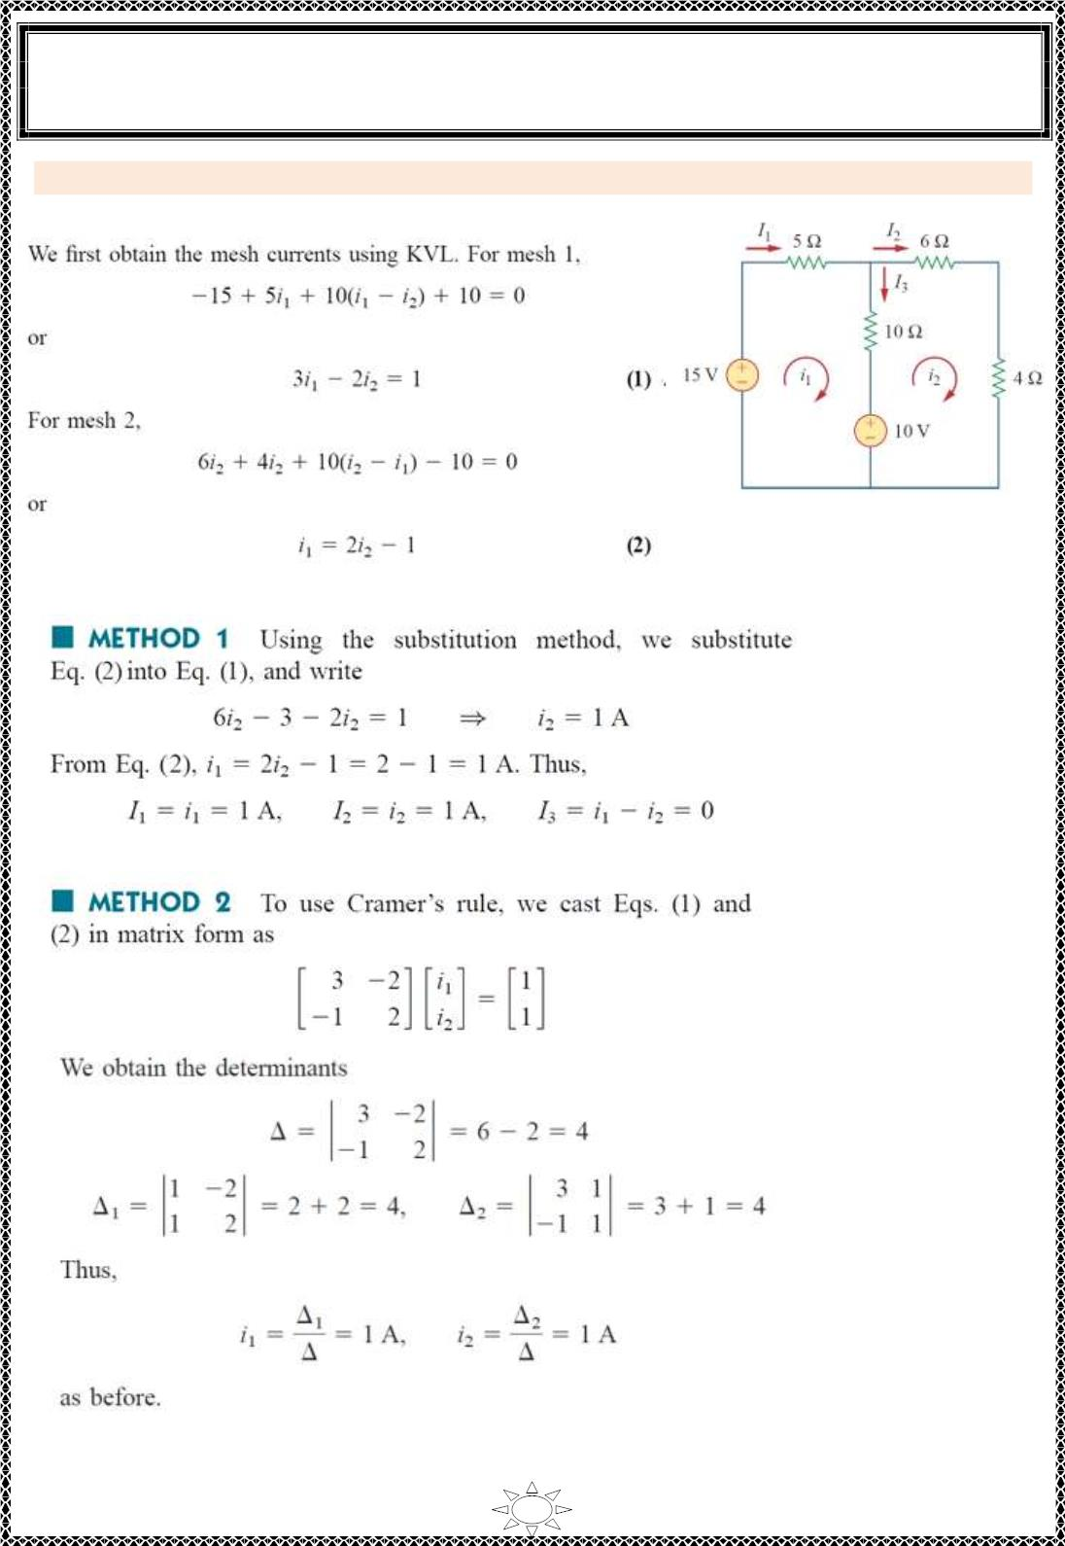
University of Diyala
Engineering College
Electronic Department
Electrical Engineering Fundamentals
1st Class
Asst., Lecturer : Wisam N. AL-Obaidi
Year (2013-2014)
Example 1: For the c irc uit in Figure (5.2), find the branch currents using mesh analysis.
Solution:
Figure (5.2)
Trail Version
Trail Version
Trail Version
Trail Version
Trail Version
Trail Version
Trail Version
Trail Version
Trail Version
Trail Version
Trail Version
Trail Version
Trail Version
64

Slide 5
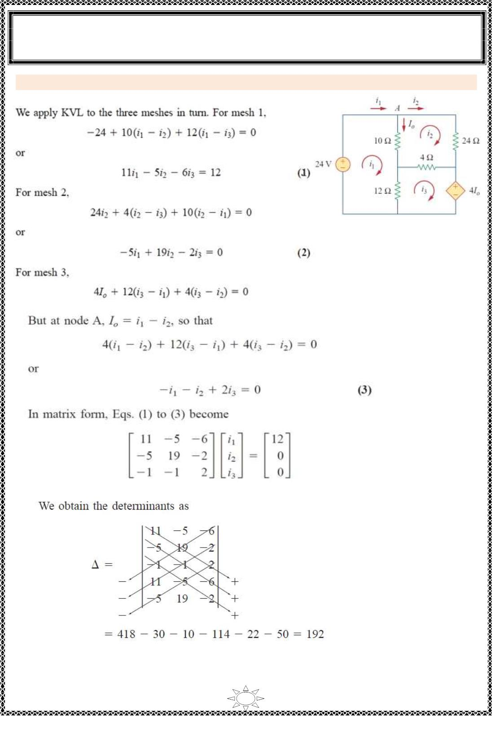
University of Diyala
Engineering College
Electronic Department
Electrical Engineering Fundamentals
1st Class
Asst., Lecturer : Wisam N. AL-Obaidi
Year (2013-2014)
Example 2: Use mesh analysis to find the current I_{o} in the circuit of Figure (5.3).
Solution:
Figure (5 .3)
Trail Version
Trail Version
Trail Version
Trail Version
Trail Version
Trail Version
Trail Version
Trail Version
Trail Version
Trail Version
Trail Version
Trail Version
Trail Version
65

Slide 6
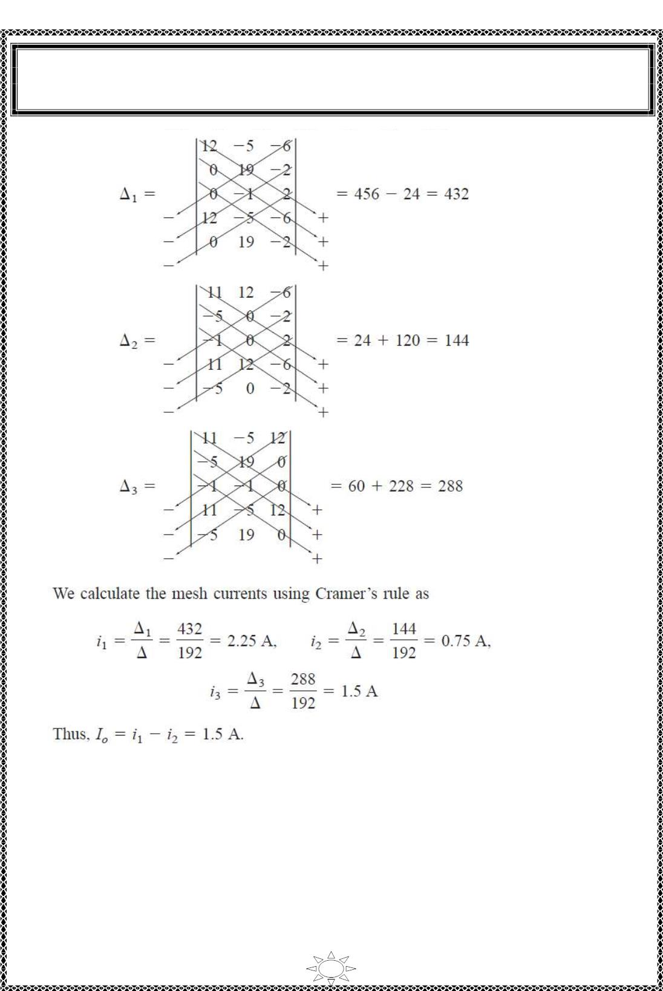
University of Diyala
Engineering College
Electronic Department
Electrical Engineering Fundamentals
1st Class
Asst., Lecturer : Wisam N. AL-Obaidi
Year (2013-2014)
Trail Version
Trail Version
Trail Version
Trail Version
Trail Version
Trail Version
Trail Version
Trail Version
Trail Version
Trail Version
Trail Version
Trail Version
Trail Version
66

Slide 7
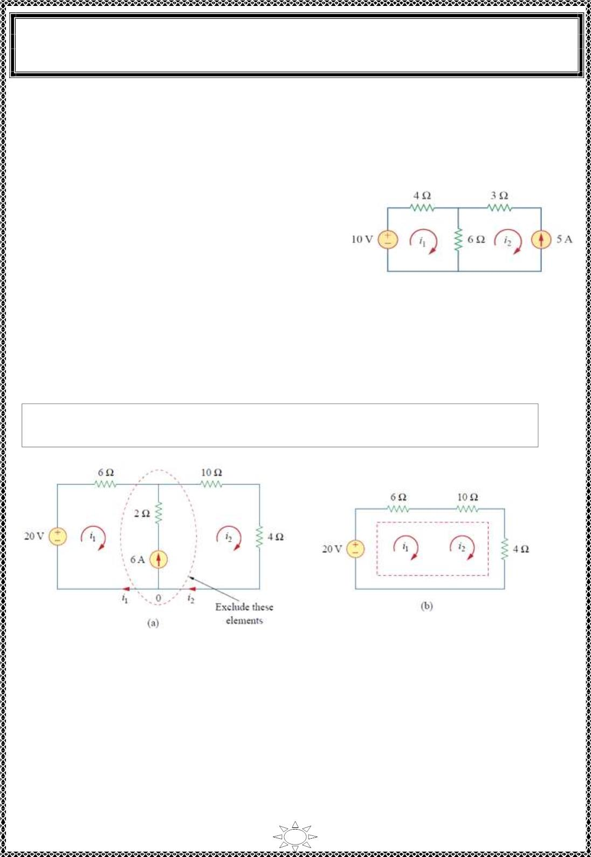
University of Diyala
Engineering College
Electronic Department
Electrical Engineering Fundamentals
1st Class
Asst., Lecturer : Wisam N. AL-Obaidi
Year (2013-2014)
Mesh Analysis with Current Sources
Applying mesh analysis to c irc uits containing current sources (dependent or independent)
may appear c omplic ated. But it is actually much easier, because the presence of the current
s ources red uc es the number of equations. Cons ider the following two poss ible cases.
■ C ASE 1 when a current source exists o nly in one
mesh: Consider the circuit in Figure (5.4) , for
examp le. We set i₂ = -5 A and writ e a mesh equation
for the other mesh in the usual way; that is,
-10 + 4i + 6(i – i ) = 0, and i = -5 A
1
1
2
2
Figure (5.4)
∴ i₁ = -2 A
■ C ASE 2 When a current source exists between two meshes : Consider the c ircuit in
Figure (5.5)(a) , for examp le. We create a supermesh by excluding the current source and
any e le me nts connected in series wit h it, as s hown in Figure (5.5)(b). Thus,
Trail Version
Trail Version
Trail Version
Trail Version
Trail Version
Trail Version
Trail Version
Trail Version
Trail Version
Trail Version
Trail Version
Trail Version
Trail Version
A supermesh results when two meshes have a (dependent or independent) current
source in common.
Figure (5 .5)
From Figure (5 .5)(a), Ap p ly ing KCL to node 0 in,
i = 6 + i A
…(1)
…(2)
2
1
So from Figure (5 .5)(b), the mesh equation is ,
- 20 + 6i +10i + 4i = 0
1
2
2
6i +14i = 20
1
2
Solving equation (1) & (2), we get,
i₁ = -3.2 A and i₂ = -2.8 A
67

Slide 8
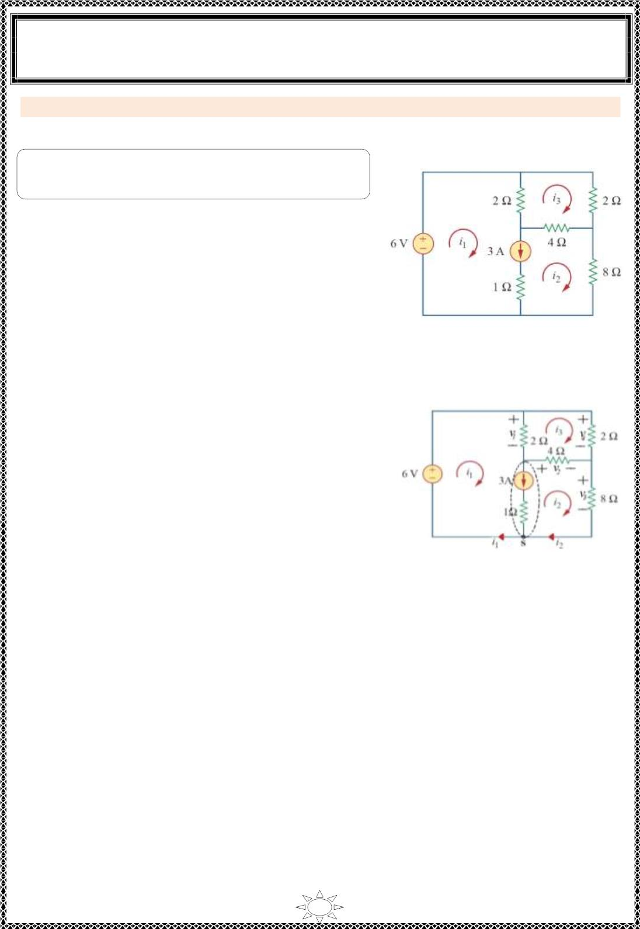
University of Diyala
Engineering College
Electronic Department
Electrical Engineering Fundamentals
1st Class
Asst., Lecturer : Wisam N. AL-Obaidi
Year (2013-2014)
Example 3: Use mesh analysis to determine i , i & i for the c irc uit in Figure (5.6).
Solution:
1
2
3
Note: mesh (1) & mesh (2) are supermesh, because
there exists a current source between them.
For supermesh (1) & (2):
1) Find the relat ion among i , i and the current
1
2
source, so take node (s) in Figure (5.7) and
apply KCL to find th is relation.
i = i + 3
…(1)
1
2
Figure (5.6)
2) Eliminate the current source branch as in Figure (5.7) and write the supermesh
equation as follows ,
Trail Version
Trail Version
Trail Version
Trail Version
Trail Version
Trail Version
Trail Version
Trail Version
Trail Version
Trail Version
Trail Version
Trail Version
Trail Version
v = 2(i – i ), v = 4(i – i ), v = 8i & v = 2i
1
1
3
2
2
3
3
2
4
3
–6 + v + v + v = 0
1
2
3
–6 + 2(i – i ) + 4(i – i ) + 8i = 0
1
3
2
3
2
2i + 12i – 6i = 6
} ÷ 2
1
2
3
∴ i + 6i – 3i = 3
…(2)
1
2
3
Figure (5.7)
For mesh (3):
v – v – v = 0
4
2
1
} ÷ −2
…(3)
2i – 4(i – i ) – 2(i – i ) = 0
3
2
3
1
3
–i + 2(i – i ) + (i – i ) = 0
3
2
3
1
3
∴ i + 2i – 4i = 0
1
2
3
Solve equ.s (1), (2) & (3) we get,
i = 3.474 A, i = 0.4737 A, i = 1.1052 A.
1
2
3
68

Slide 9
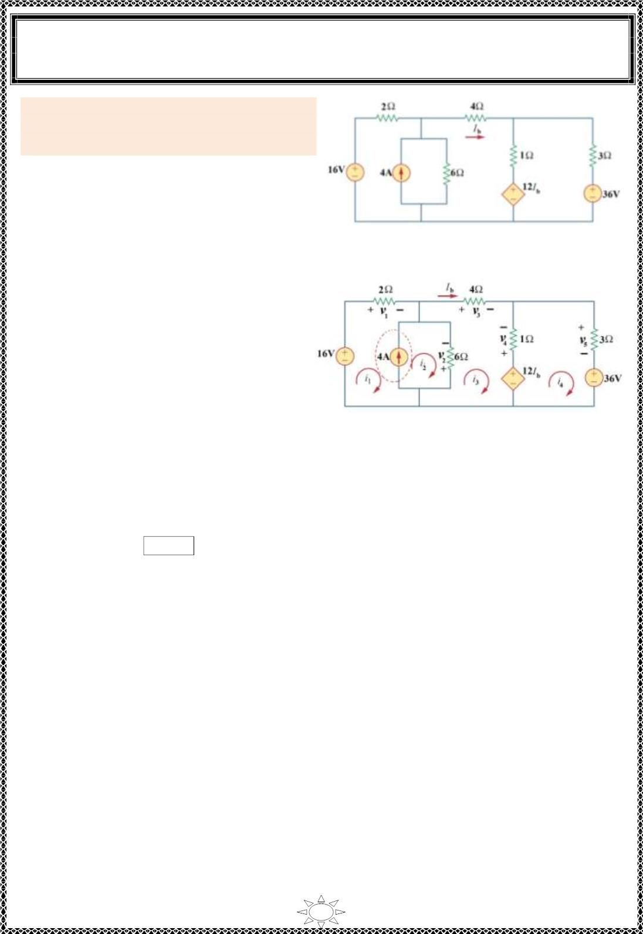
University of Diyala
Engineering College
Electronic Department
Electrical Engineering Fundamentals
1st Class
Asst., Lecturer : Wisam N. AL-Obaidi
Year (2013-2014)
Example 4: Use mesh analysis to determine
the current flowing in the (4Ω) resistor for
the circuit shown in Figure (5.11).
Solution:
Redraw the circuit as shown below &
indicate the voltage polar it ies on each
element in the c irc uit.
Figure (5 .11)
For supermesh (1) & (2):
i = i + 4
…(1)
2
1
v = 2i , v = –6(i – i )
1
1
2
2
3
–16 + v – v = 0
1
2
–16 + 2i + 6(i – i )= 0
1
2
3
∴ 2i + 6i – 6i = 16
… (2)
1
2
3
Substitute Equ.(1) in (2), we get,
2i + 6(i + 4) – 6i = 16
1
1
3
Trail Version
Trail Version
Trail Version
Trail Version
Trail Version
Trail Version
Trail Version
Trail Version
Trail Version
Trail Version
Trail Version
Trail Version
Trail Version
∴ 8i – 6i = – 8
… (3)
Figure (5.12)
1
3
For mesh (3):
v = 4i , v = –1(i – i )
3
3
4
3
4
12I – v + v + v = 0
b
4
3
2
12I + 1(i – i ) + 4i – 6(i – i )= 0
b
3
4
3
2
3
It is clearly that, I = i
b
3
∴ – 6i + 23i – i = 0
…(4)
…(5)
2
3
4
Substitute Equ.(1) in (4), we get,
∴ – 6i + 23i – i = 24
1
3
4
For mesh (4):
v₅ = 3i₄
36 – 12I + v + v = 0
b
4
5
36 – 12 i + v + v = 0
3
4
5
36 – 12 i –1(i – i ) + 3i = 0
3
3
4
4
∴ 13i – 4i = 36
…(6)
3
4
Solve Equ.s (3), (5) & (6) we get,
−6 −8
−6 23 −1ꢀ ꢁ ꢀ = 24ꢀ
8
0
ꢁ
1
3
0
13 −4 ꢁ
36
4
69

Slide 10
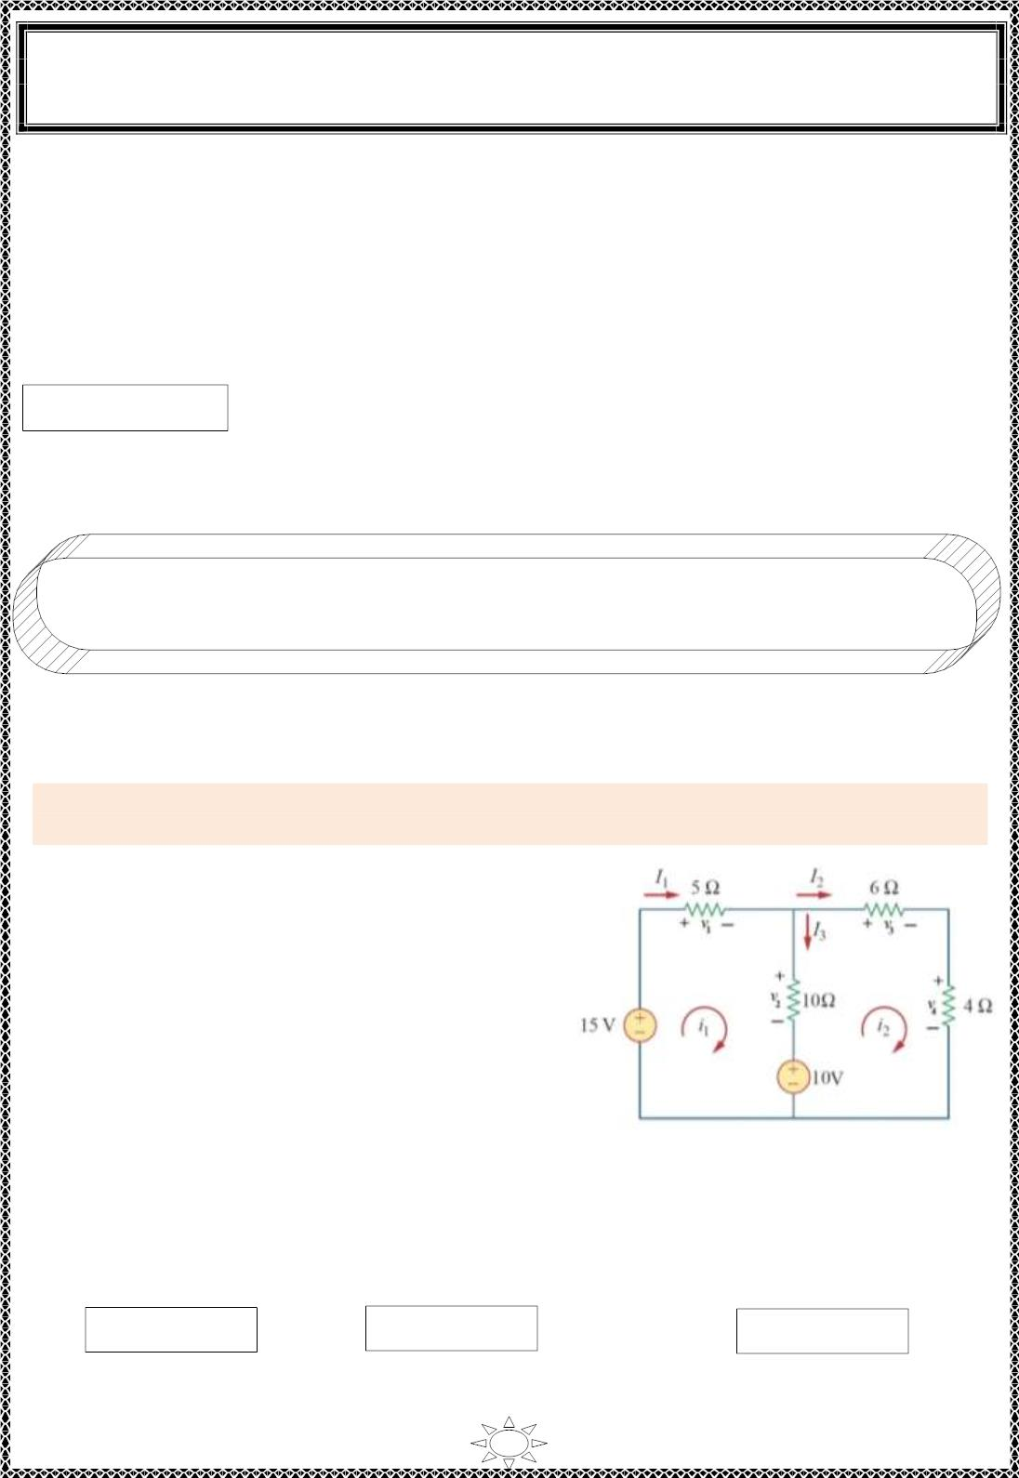
University of Diyala
Engineering College
Electronic Department
Electrical Engineering Fundamentals
1st Class
Asst., Lecturer : Wisam N. AL-Obaidi
Year (2013-2014)
ꢀ
8
−6
0
⁻¹ −8
1
ꢀ ꢁ = −6 23 −1ꢁ 24ꢁ
2
ꢀ
0
13 −4
36
3
ꢀ
−0.557
1
∴ ꢀ ꢁ = 0.59 ꢁ
3
ꢀ
−7.082
4
∴ I = i = 0.59 A
b
3
Note :- mesh paths can take different ways as explained in Examples (6), (7) & (8),
but note that each element in the circuit must carry one loop or mor e.
Trail Version
Trail Version
Trail Version
Trail Version
Trail Version
Trail Version
Trail Version
Trail Version
Trail Version
Trail Version
Trail Version
Trail Version
Trail Version
Example 5: Use mesh analysis to determine the branch currents I , I & I for the circuit
shown in Figure (5.13).
Solution:
1
2
3
For mesh (1):
–15 + v + v + 10 = 0, v = 5i & v = 10(i – i )
1
2
1
1
2
1
2
–15 + 5i + 10(i – i ) + 10 = 0
1
1
2
15i – 10i = 5 } ÷ 5
1
2
∴ 3i – 2i = 1
…(1)
1
2
For mesh (2):
v + v – v – 10 = 0, v = 6i & v = 4 i
3
4
2
3
2
4
2
6i + 4 i – 10(i – i ) – 10 = 0
2
2
1
2
Figure (5.13)
–10i + 20i = 10 } ÷ 10
1
2
∴ –i + 2i = 1
…(2)
1
2
Solve Equ.s (1) & (2) simultaneously or by Grammer's rule or by matrix inv ers io n method
to find mesh currents,
∴ i = 1A, i = 1A
1
2
I = i = 1A,
I = i = 1A
&
I = i –i = 0A
3 1 2
1
1
2
2
70

